Slide 1
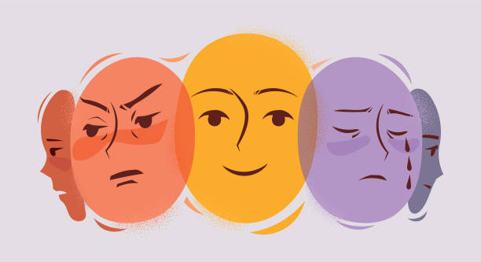
從面部表情到情緒洞察： 用於心理健康自檢和治療監控

Slide 2
Background
1. Modern Stressors:
Fast-paced lifestyles
High-intensity work pressure
Overwhelming social media presence
2. Prevalent Issues:
Anxiety and depression
3. The Role of Emotion Recognition Technology:
Offers new possibilities for mental health monitoring
Enhances personal mental well-being

Slide 3
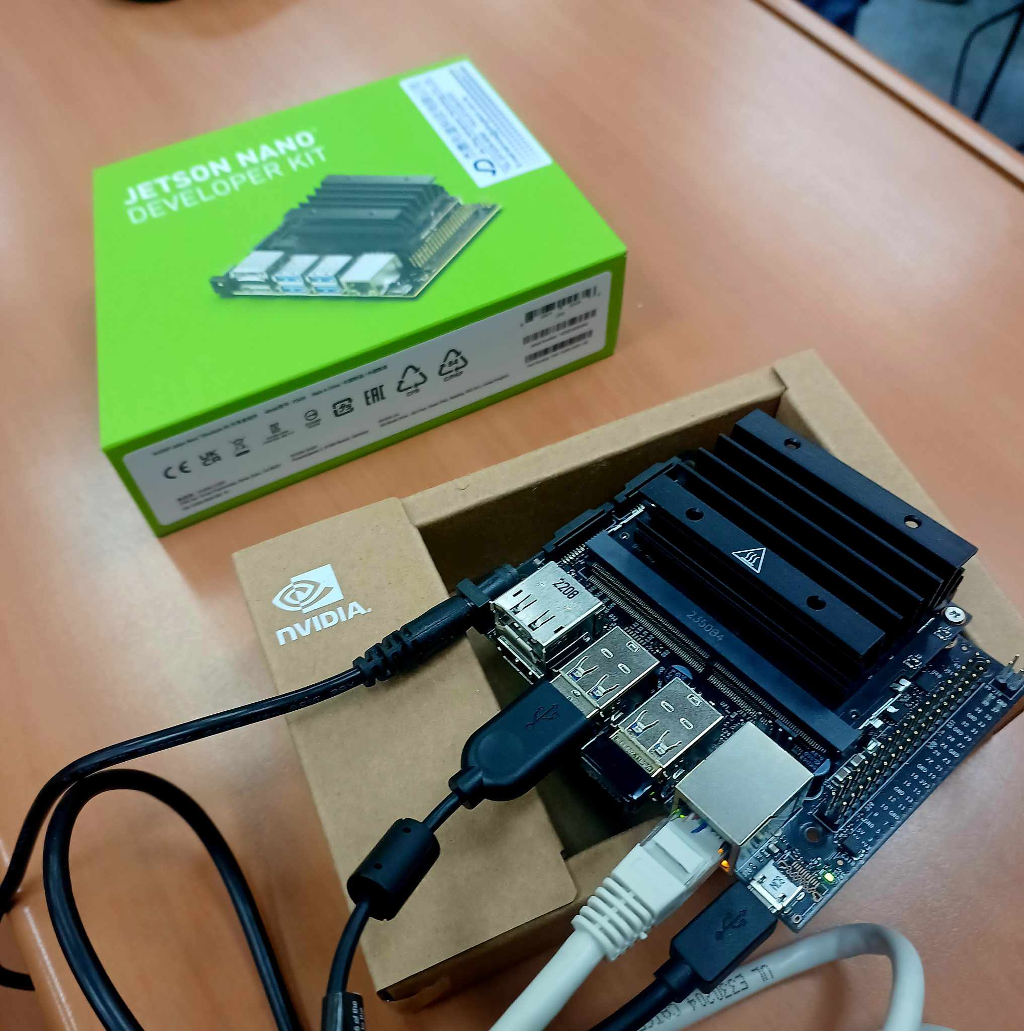
Expected Goals
Equipment
USB Camera, Monitor, Nvidia Jetson Nano
Objectives
1. Real-Time Emotion Display:
Show users their current emotional state to enhance emotional management skills.
2. Instant Emotional Feedback:
To improve mental health and well-being, provide real-time feedback.
3. Emotion Daily Report

Slide 4
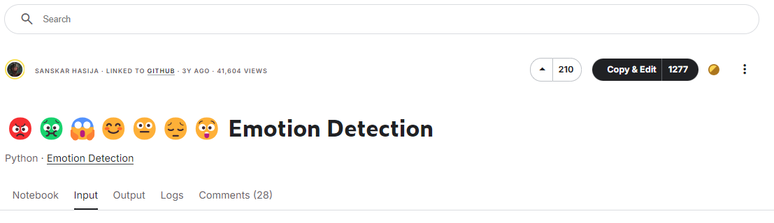
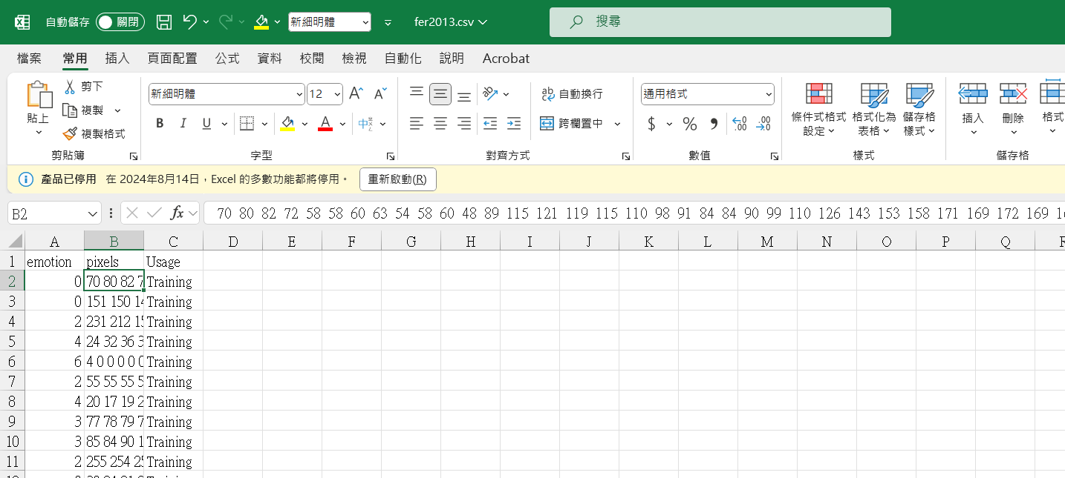
Dataset Overview
Source
Kaggle-fer2013
Dataset
CSV file
35,887 data points
7 emotions
48*48 grayscale pixel

Slide 5







Dataset Overview
angry
disgusted
fear
happy
neutral
sad
surprised

Slide 6
Data Preparation
Model
Transformation
Resize(224)
RandomHorizontalFlip
RandomRotation(10)
Normalize
Splitting
Training 80%
Validation 20%
Base Model
ResNet18(Pre-trained)
Modifications
Input layer(grayscale)
Output layer(7 labels)

Slide 7
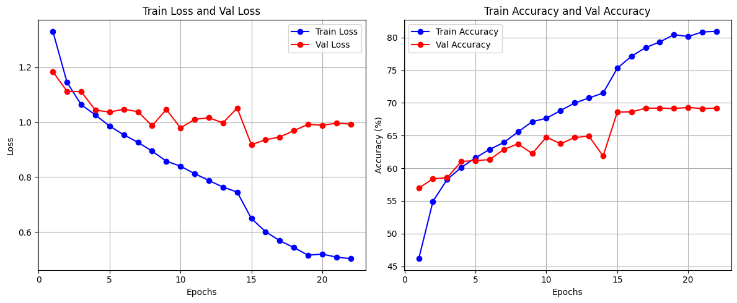
Training
Loss Function : CrossEntropyLoss
Optimizer : Adam+lr_scheduler
Early Stopping : patience=7

Slide 8
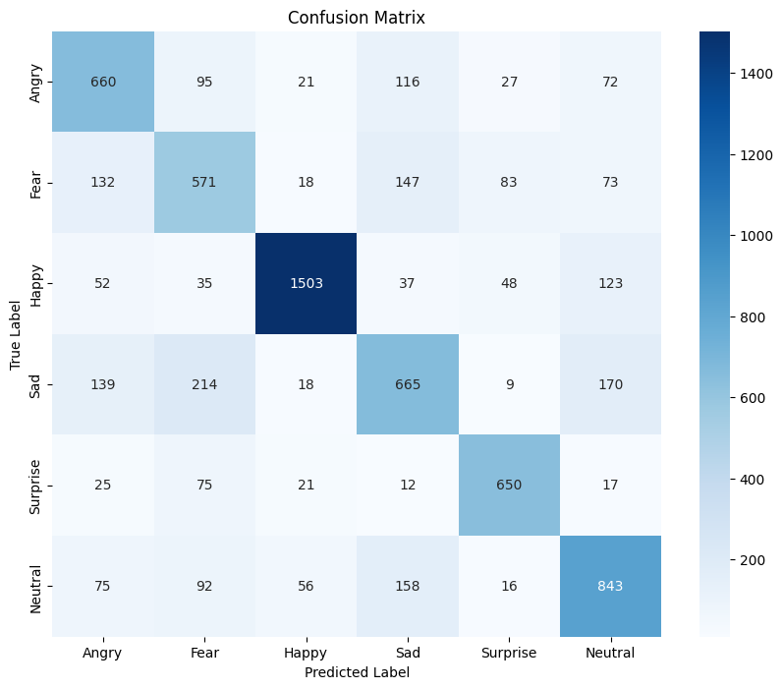
Confusion Matrix

Slide 9
Comparison with others
Base model | ResNet18 | Ensemble 5 Models[1] | CNN 20 layers
Source | Ourself | Competition 3rd | Network
Framework | PyTorch | PyTorch | TensorFlow
Validation Accuracy | 70% | 75% | 65%
[1] efficientnet_b2b、efficientnet_b3b、cbam_resnet50、hrnet_w64、resnest269e

Slide 10





Fine-tuned Model
1. The majority of the dataset consists of foreigners
2. Dataset is not suitable for ourself
Fine-tuned model using our face dataset

Slide 11
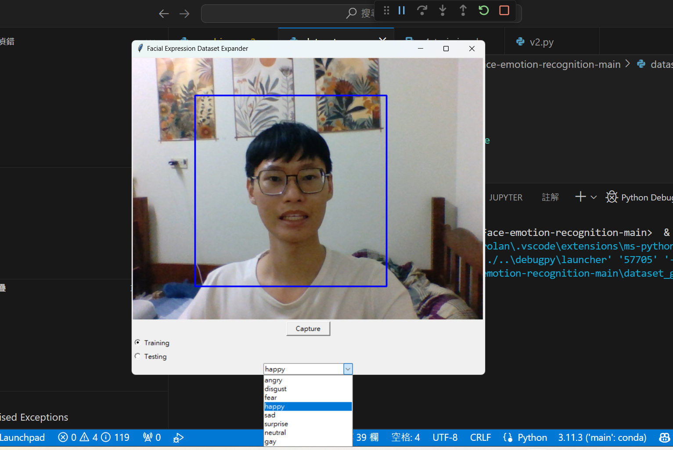
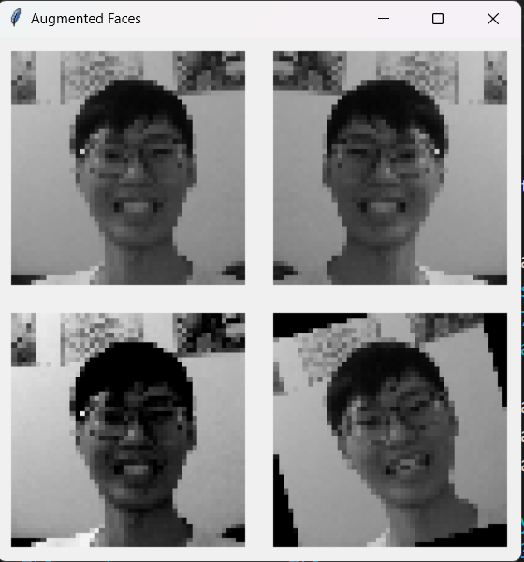
Generate Dataset
OpenCV Face Detection
Capture button
Select your emotion

Slide 12
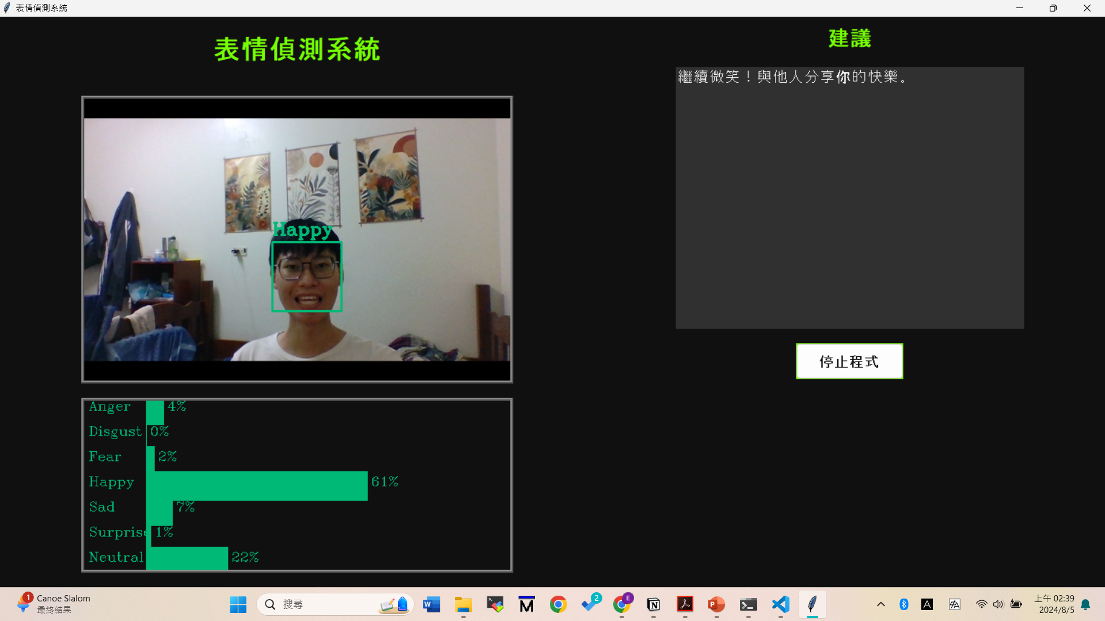
GUI Design
OpenCV Face Detection & Emotion Prediction
Suggestion
Camera
Input
Stop
Botton
Probability

Slide 13
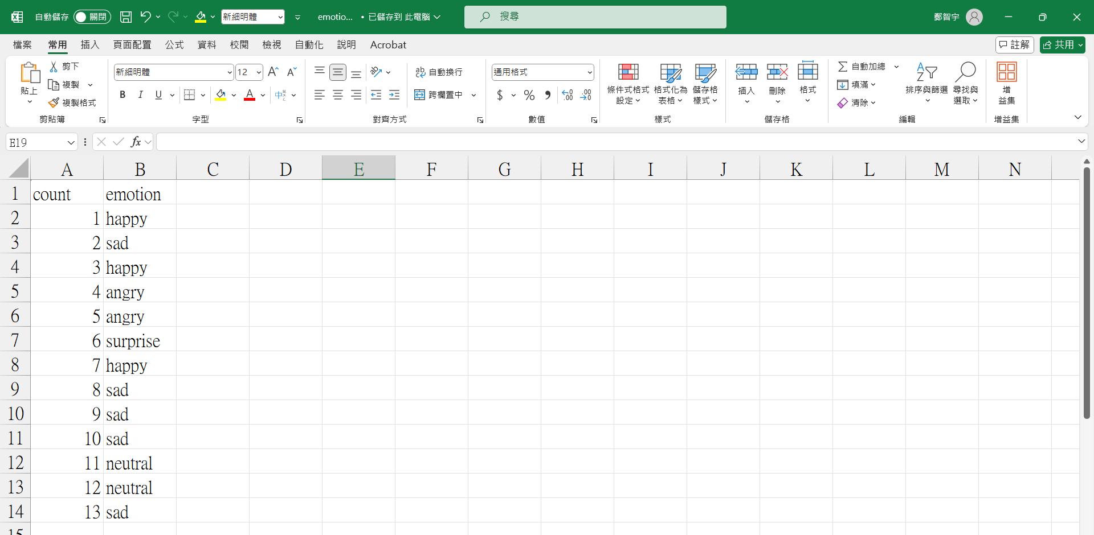
Emotion Daily Report
Output File: emotion.csv
Record count
Emotion

Slide 14
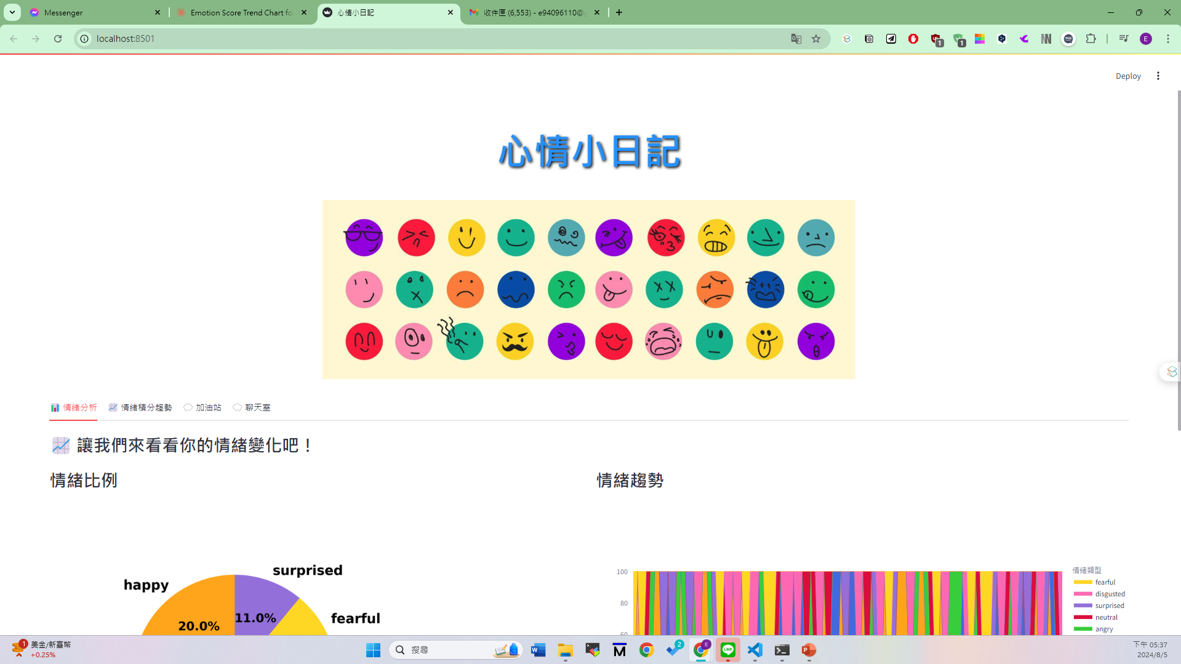
Emotion Daily Report
Website at local
Technologies Used
Streamlit, CSS, HTML
Large Language Model
Implemented Features
Emotion-related distribution
Generate encouraging message based on data
Chat box

Slide 15
Report Demo Video
https://youtu.be/MeRyqVefBMA

Slide 16
Future Work
1. Mental Health Monitoring and Therapy Support
Enhance mental health assessment and treatment through
real-time emotion tracking.
2. Learning State Monitoring
Observe and optimize students' learning experiences by monitoring emotional states.
3. Employee Emotion Tracking
Improve workplace well-being by tracking employee emotions.
4. Emotional Customer Service
Develop systems that understand and respond to customer emotions.

Slide 17
Thank you

